Slide 1
Building a Care Facility Where You’d Want to Live
Rudy P. Friesen MAA (ret.), FRAIC, Hon FAIA, LEED AP
Partner Emeritus
friesen@ft3.ca
www.ft3.ca

Slide 2
I could be a dementia statistic
747,000 Canadians have Alzheimer’s or other dementia, 1,400,000 by 2031 estimated − CIHR, Government of Canada
35 million people over 65 in US, double by 2030 − Green House website
80% of seniors in nursing homes have dementia − CBC News
LTC residents: 200,000 in 2011 to 690,000 in 2038 − CUPE/Dementia Support
How about you?
“It’s a global epidemic and it is only getting worse.” − Marc Wortmann (ADI)

Slide 3
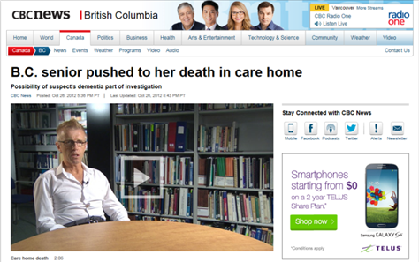
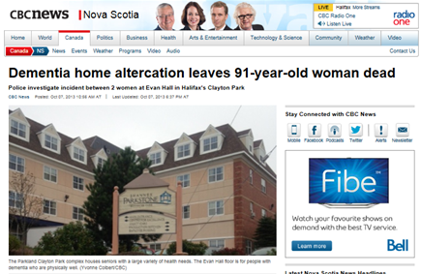
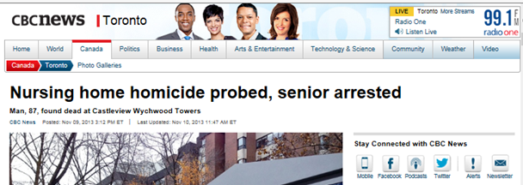
I DON’T want to …
make the headlines or be housed with people who do
How about you?

Slide 4
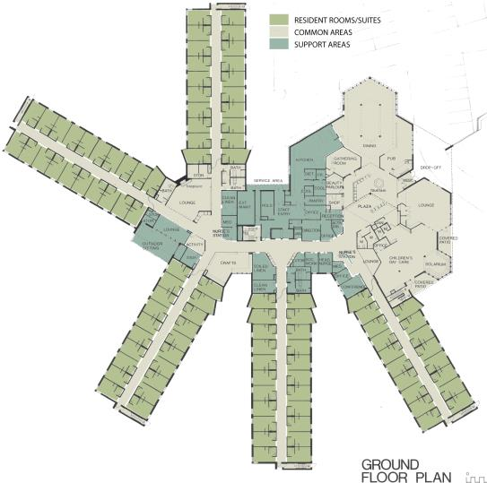
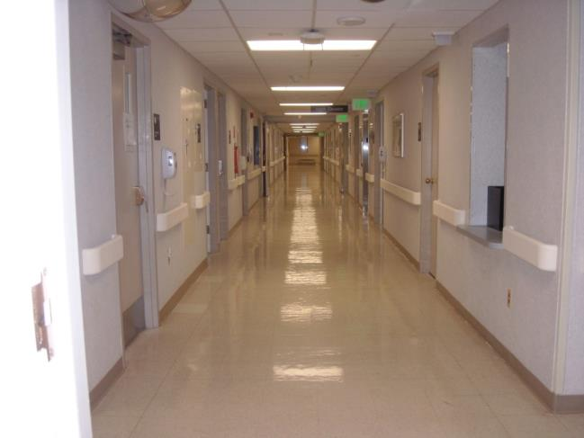
I DON’T want to …
be warehoused in an institutional facility
Maples Personal Care Home
Location: Winnipeg, MB
Architect: ft3
Date: 1979 to 1981
How about you?

Slide 5
I DON’T want to …
live in unfamiliar surroundings
How about you?

Slide 6
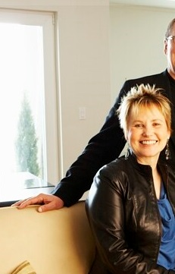
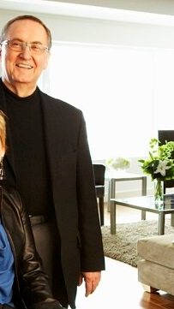
I DON’T want to …
be separated from my spouse
How about you?

Slide 7
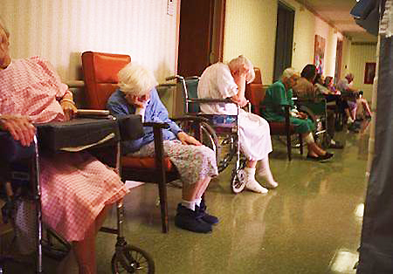
I DON’T want to …
slump in a wheelchair in a long corridor
How about you?

Slide 8
I DON’T want to …
be dictated to: told when to get up, when to eat, what to do
How about you?

Slide 9
I DON’T want to …
be cared for by caregivers who look like hospital staff
How about you?

Slide 10
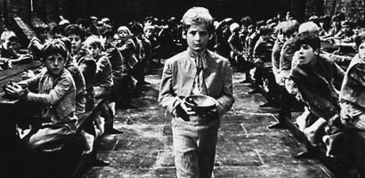
I DON’T want to …
eat institutional food
How about you?

Slide 11
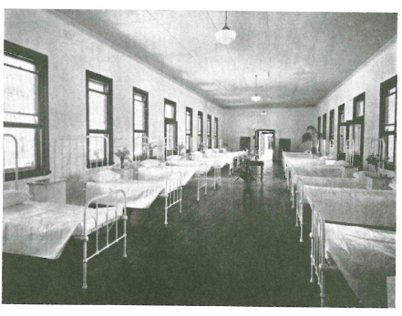
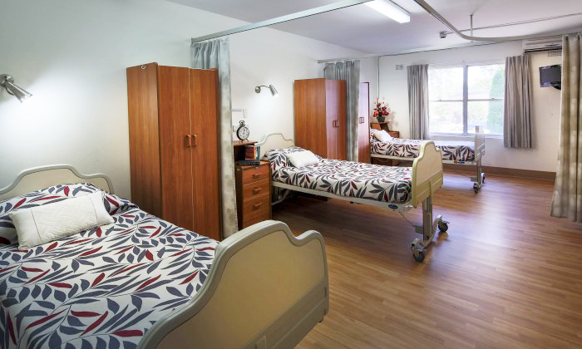
I DON’T want to …
be stuck in an institutional bedroom or
share a bedroom with anyone
How about you?

Slide 12
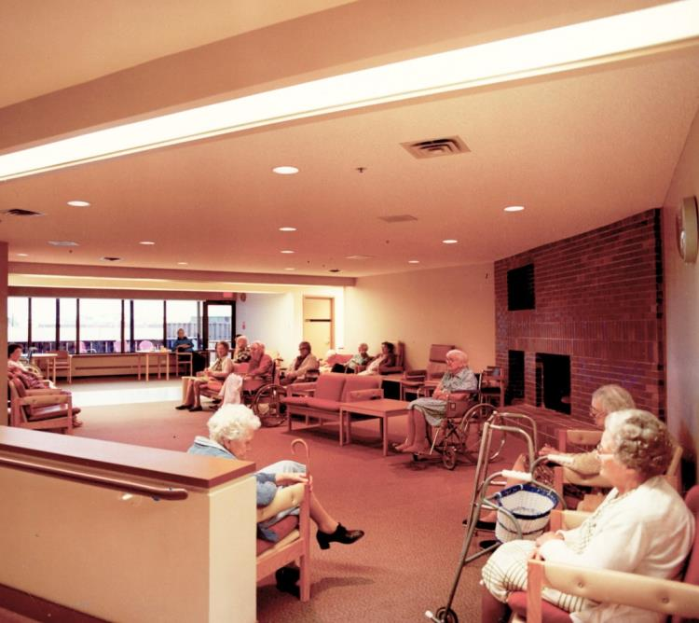
I DON’T want to …
be with people I have nothing in common with except dementia
How about you?

Slide 13
I DON’T want to …
be confined to a facility or
feel like I am living in a ghetto or jail
How about you?

Slide 14
“1.6 million people are confined to those institutions….
Their only crime is frailty…most are serving life sentences without the possibility of parole.”
− Dr. Bill Thomas

Slide 15
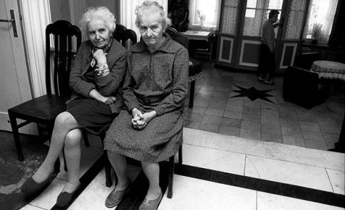
I DON’T want to …
sit by the front door, wanting to go home because I don’t feel at home
How about you?

Slide 16
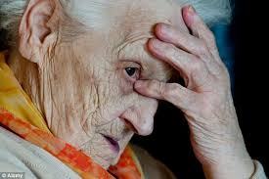
I DON’T want to …
be managed with drugs and turn into a zombie
How about you?

Slide 17
I DON’T want to …
have my friends and relatives barred for asking too many questions
How about you?

Slide 18
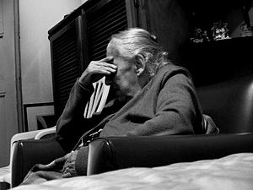
I DON’T want to …
be put on the Alzheimer’s track
undergo a battery of invasive tests
given an out-dated label
institutionalized
drugged
left to slump in a wheelchair
suffer an accelerated demise
How about you?

Slide 19
“I believe that in the nursing home every year, thousands and thousands of people die of a broken heart.
They die not so much because their organs fail, but because their grip on life has failed.”
− Dr. Bill Thomas

Slide 20
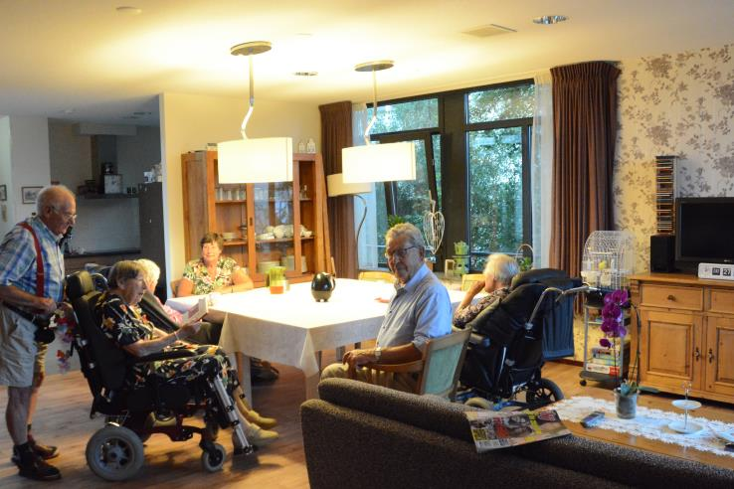
I DO want to …
live in a home-like environment
How about you?

Slide 21
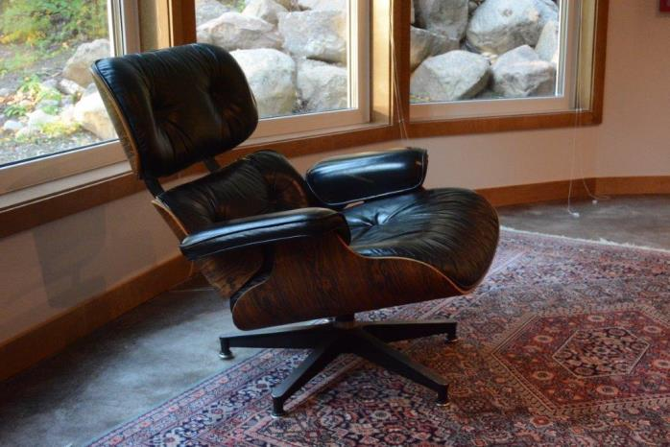
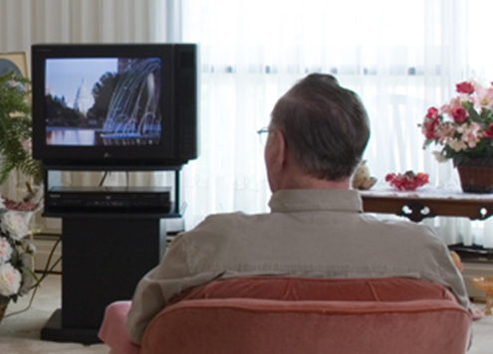
I DO want to …
How about you?
have familiar things in my room, watch TV in my favourite chair

Slide 22
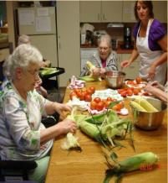
I DO want to …
have food prepared in my household, and smell cooking
How about you?

Slide 23
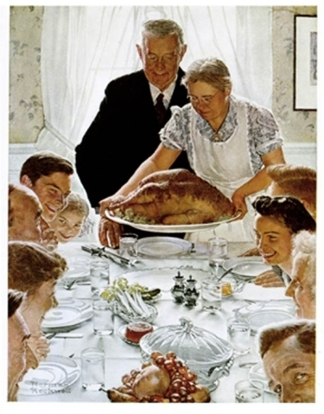
I DO want to …
How about you?
enjoy family-style dining with supper as a special event each day

Slide 24
Family-style dining
less medication used
less food wasted
improved health & energy
improved body weight
improved fine motor functioning
richer social interaction, better communication
fewer pain and behaviour issues
higher quality of life
“For people with dementia, food may be the last thing they lose interest in.” Keith Schaeffer, author, “

Slide 25
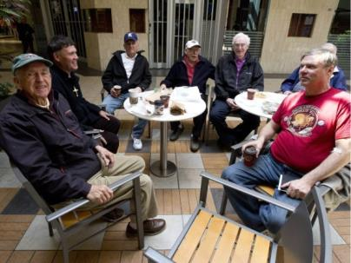
I DO want to …
have flexible and familiar routines, get up, go to bed, bathe, and eat meals when I like
How about you?

Slide 26
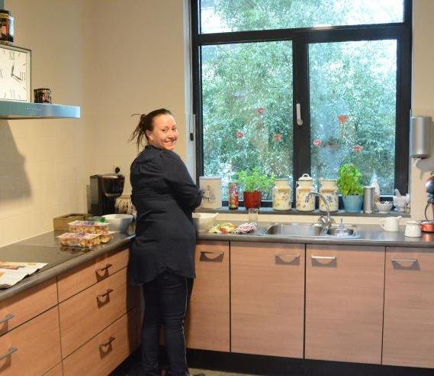
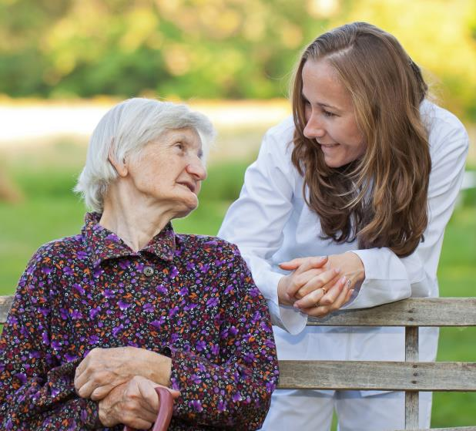
I DO want to …
have compassionate caregivers
How about you?

Slide 27
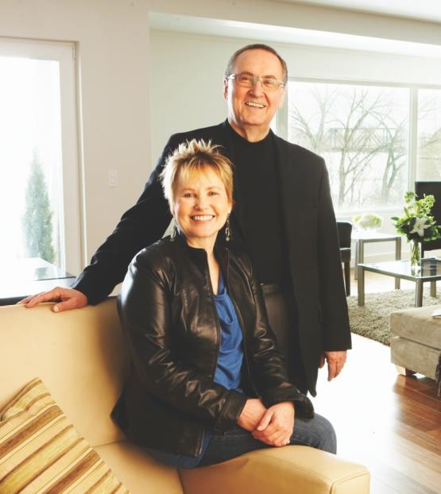
I DO want to …
live with my spouse or have her close by
How about you?

Slide 28
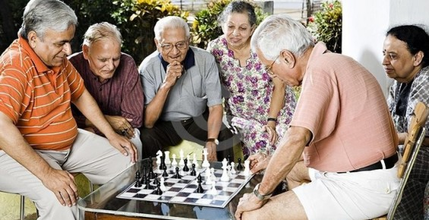
I DO want to …
live with compatible people in my household; interact or retreat to my own room
How about you?

Slide 29
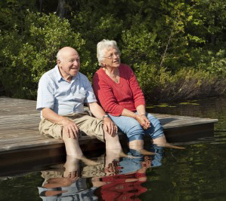
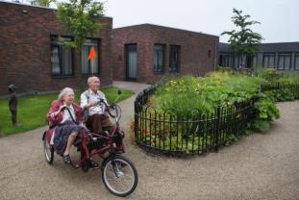
I DO want to …
have safe outdoor access, with the help of technology
How about you?

Slide 30
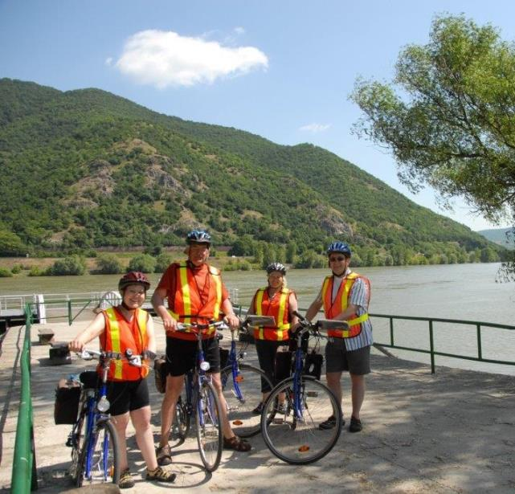
I DO want to …
go places
go outdoors
wander through stores
go to Tim Hortons
be taken to concerts and art galleries
go out for dinner
go on trips and bicycle tours, like they do in Denmark
How about you?

Slide 31
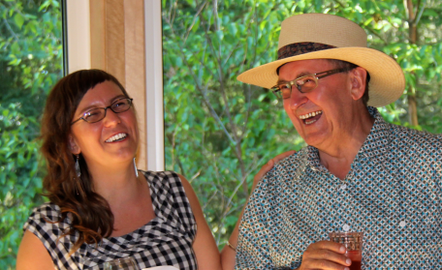
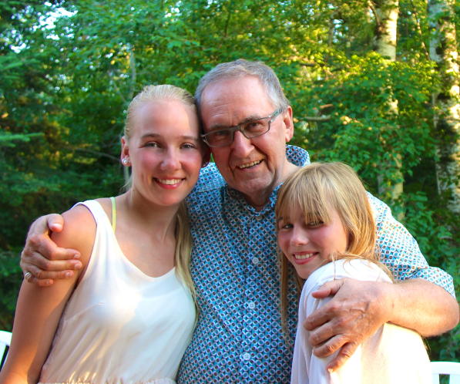
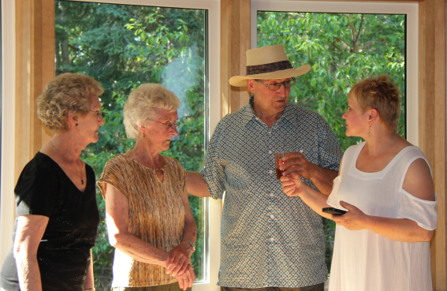
I DO want to …
visit with friends and relatives
How about you?

Slide 32
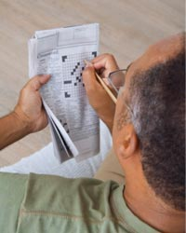
I DO want to …
read books & newspapers, do crossword puzzles
How about you?

Slide 33
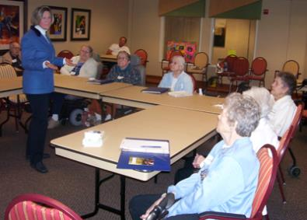
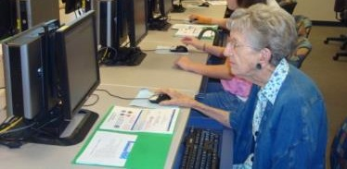
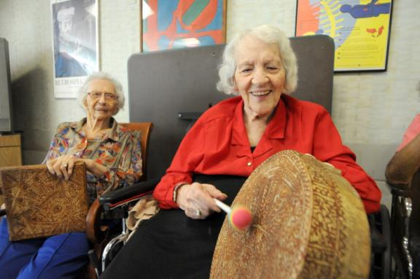
I DO want to …
be challenged to learn new things
How about you?

Slide 34
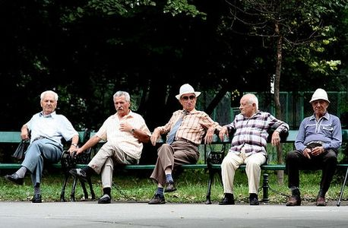
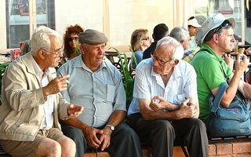
I DO want to …
feel like I am living in a “normal” community
How about you?

Slide 35
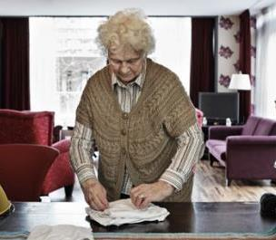
I DO want to …
be put on a humane track
diagnosed as brain-aging
focus on what I can still do
age with dignity
function independently
feel a sense of normalcy, connectedness, usefulness--despite cognitive challenges
live in a household model facility
How about you?

Slide 36
Household Model
resident-centred care – unique interests, abilities & needs
home-like – 5 to 10 residents/household
self-led multi-skilled care team – food prep, housekeeping, activities
living/dining/kitchen, private bedrooms
flexible schedules – meals, bathing, sleeping
free access to outdoors
significant drop in drug use, behavioural issues
higher quality care
less costly to operate

Slide 37
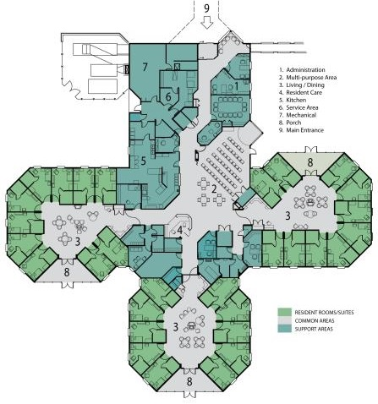
I might be happy in …
Fisher Personal Care Home
household model
lifestyle based on residents’ past
compatible family groups
10 residents/household
respect for individual needs
flexible and familiar routines
multi-skilled (housekeeping, dietary activities) caregivers for each home
How about you?

Slide 38
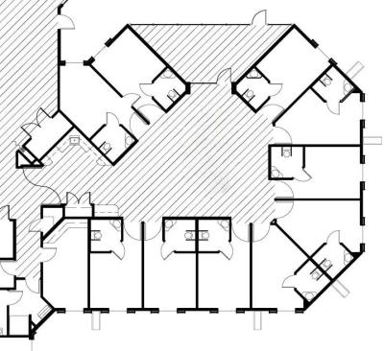
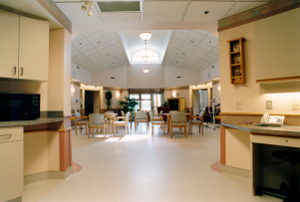
I might be happy In …
Fisher Personal Care Home
Location: Fisher Branch, MB
Architect: ft3
Date: 1994 to 1999
30 residents – 10 residents/household

Slide 39
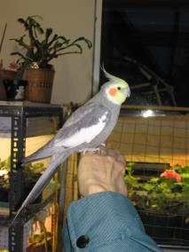
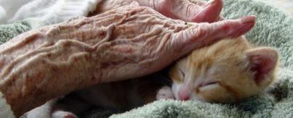
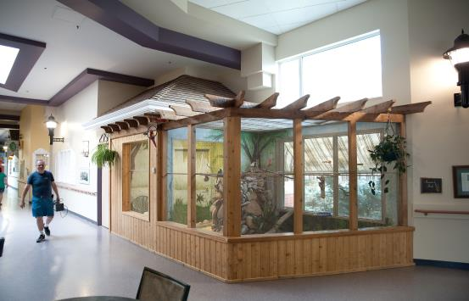
I might be happy in …
Eden Alternative, 1994
elder-centred community with human habitat: plants, animals, children
well-being for those with dementia
alternatives to medication
person-directed care philosophy
addresses three plagues: loneliness, helplessness, and boredom
How about you?

Slide 40
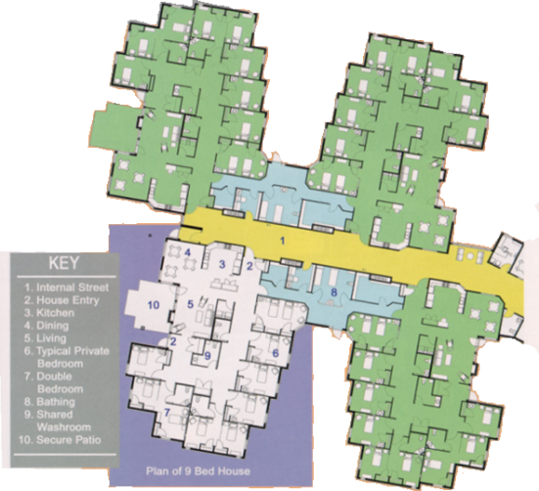
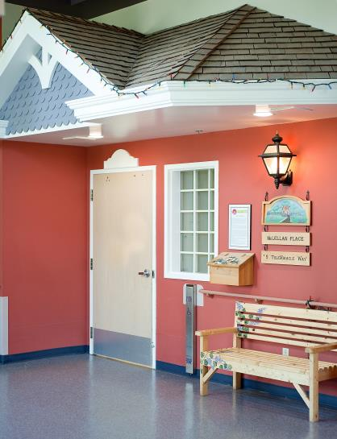
I might be happy in …
Eden Alternative: Sherbrooke Community Centre
Location: Saskatoon, SK
Architect: AODBT
Date: 1998-1999
36 residents – 9 residents/household
How about you?

Slide 41
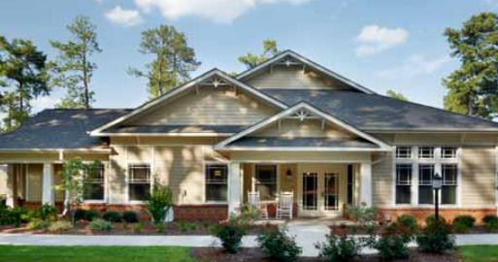
I might be happy in …
Green House Project, 2003
clusters of small, cozy houses, 8 to 10 residents/house
a place like home
open kitchen for meal preparation
five year, $10 million from foundation
self-managed, cross-trained team
clinical support team
How about you?

Slide 42
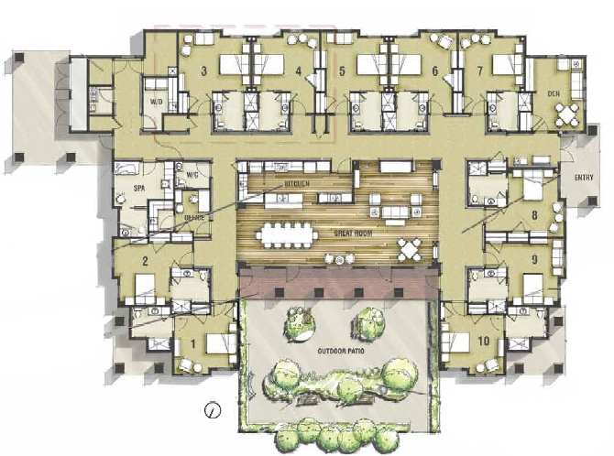
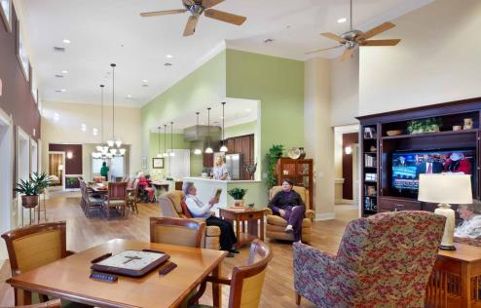
I might be happy in …
Green House Project: Penick Village
Location: Winston Salem, NC
Date: 2010
Architect: CJMW Architecture
10 residents – 10 residents/house
How about you?

Slide 43
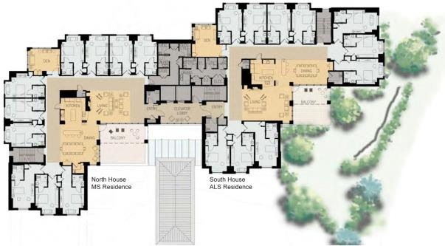
I might be happy in …
Green House Project: Leonard Florence Center for Living
Location: Chelsea, MA
Architect: DiMella Shaffer Associates, Inc.
Date: 2010
100 residents – 10 residents/household
How about you?

Slide 44
I might be happy in …
QUIS-EH-O: Salem Home
Location: Winkler, MB
Architect: ft3
Date: 1983 to Present
modified institutional facility
146 residents
9 dining rooms
relationship-centred care

Slide 45
I might be happy in …
De Hogeweyk, The Netherlands 2009
152 residents with severe or extreme dementia
small “village” of 23 households, 6 to 7 residents/household
activities/facilities that attract non-residents
microcosm of a Dutch city
How about you?

Slide 46
De Hogeweyk Core Principles
Relieve anxiety, confusion, anger by providing:
a safe, familiar and normal environment;
an almost-normal home surrounded by recognizable things and similar people.
Maximize quality of life by focusing on:
everything residents can still do, not on what they can’t do.
LTC residents spend an average of 96 seconds/day outdoors;
60% never receive visitors – Dutch Alzheimer Association

Slide 47
De Hogeweyk Site Plan
50% of site open area
building forms boundary/security
one entrance
no locks, residents free to roam day and night
restaurant, grocery store, meeting rooms near entrance

Slide 48
De Hogeweyk Lifestyles Selection Guide
guide (80 questions) developed by Motivaction (www.motivaction.nl)
professional, political, religious interests
music, art, food, hobby preferences
social or private activities
daily activities and routines
“Lifestyle groupings maximize harmony and mutual interest.”

Slide 49
De Hogeweyk Lifestyle Categories
Homemaker
Well-to-do
Urban
Cultural
Indonesian
Manly
Christian

Slide 50
De Hogeweyk Homemaker Lifestyle
neat, spotlessly clean
knick-knacks, display cabinets
pottery, vases
pictures of windmills
photos of grandchildren

Slide 51
De Hogeweyk Well-to-do Lifestyle
period furniture, china cabinets
elegant fireplace, chandeliers
paintings on walls, classical music
cloth napkins, lace tablecloths
discreet kitchen
staff act like “servants”, treat residents formally, perform chores unseen

Slide 52
De Hogeweyk Urban Lifestyle
lived in cities, livelier lifestyle
enjoy company, music, fun
contemporary furniture and décor
caregivers are like family
residents enjoy folding laundry, chopping onions
caregivers iron in living room, like in urban flat

Slide 53
De Hogeweyk Cultural Lifestyle
enjoy art, music, theatre
former writers, artists, musicians, connoisseurs
artwork on walls

Slide 54
De Hogeweyk Indonesian Lifestyle
for Indonesian immigrants
caregivers speak their language
larger kitchen for residents’ participation
authentic cuisine
rattan furniture
stick puppets on walls
tropical plants, fruit bowl
heating warmer in winter

Slide 55
De Hogeweyk Manly Lifestyle
for trades and crafts people, mostly men
heavier furniture, darker curtains
large TV, feet on coffee table
simple décor
simple, basic Dutch food
old gardening tools outside
masculine atmosphere (man-cave)

Slide 56
De Hogeweyk Christian Lifestyle
slightly austere furnishings
religious literature
residents say grace
Bible reading

Slide 57
De Hogeweyk Activities
25 clubs: games, dancing, gardening, music
daily tasks: peeling potatoes, shelling peas, folding laundry, having hair done
“They stimulate; give residents the feeling they still have a life.”

Slide 58
De Hogeweyk Common Indoor Areas
atrium
shops/grocery store
hairdresser
doctors’ offices
gallery
theatre
music suite
baking club room
activity room
restaurant/lounge/pub

Slide 59
De Hogeweyk Common Outdoor Areas
streets
lanes
alleys
squares
terraces
activity areas

Slide 60
De Hogeweyk Community Relationships
local artists display in gallery
schools use theatre
businesses rent various rooms, theatre for meetings/conferences
locals eat in restaurant

Slide 61
De Hogeweyk Statistic & Costs to Stay
number of residents: 152
average age: men: 79.5 years; women: 83.7 years
$7,000/month, partially from government, balance by resident on sliding scale according to wealth
includes medical costs, supplies, food, etc.
same amount spent on every resident
fresh flowers, wine, etc., paid for separately, as agreed to by family
De Hogeweyk has been rated 9.1/10.
The Dutch national average rating is 7.5/10.

Slide 62
I could be happy in …
Integrated Community
Architect: ft3
Date: 2010 to Present

Slide 63
I could be happy In …
Integrated Community
Independent Living

Slide 64
I could be happy In …
Integrated Community
Assisted Living

Slide 65
I could be happy In …
Integrated Community
Long Term Care

Slide 66
I could be happy In …
Integrated Community
Integrated

Slide 67
Our thinking needs to CHANGE…
From head-in-the-sand, hands-in-the-air, or but, but, but thinking…
to opportunity and creative possibility thinking.
Why not use technology in creative, life-enhancing ways?
Why not become best practice leaders?

Slide 68
Our values need to CHANGE
From denying those with dementia the right to a normal home…
to providing them a safe, familiar home-like environment with recognizable things and similar people.
Why not enshrine this as a basic human/elder right?

Slide 69
Our drug culture needs to CHANGE
From using expensive, debilitating drugs to manage seniors in LTC, especially those with dementia…
to using smart design and delivery methods that drastically reduce or eliminate the need for drugs.
Why not use food, light, space, companionship, and choice to strategically to affect behaviour and health?

Slide 70
Our cost-benefit analysis needs to CHANGE
From falling for the myth that change costs more…
to opening our eyes to the business case for change.
Why not consider both financial and human factors?

Slide 71
Our ethics need to CHANGE
From focusing on lack or apparent decline of LTC residents…
to maximizing their quality of life by focusing on what they can still do and how they can still grow.
Why not nurture human potential all the way to the grave?

Slide 72
Our paradigm needs to CHANGE
From ghettoizing people with dementia in medical/institutional model facilities...
to integrating LTC residents into the community in every way possible.
Why not create dementia-friendly communities and dementia-friendly cities like they do in Britain?

Slide 73
Why not start
NOW?
before WE get there…

